Slide 1
K-Means Clustering

Slide 2
What is K-Means Clustering?
K-Means is an unsupervised machine learning algorithm for grouping similar data points into clusters.
It is widely used in customer segmentation, anomaly detection, and pattern recognition.
The algorithm aims to minimize the distance between data points and their cluster centers.

Slide 3
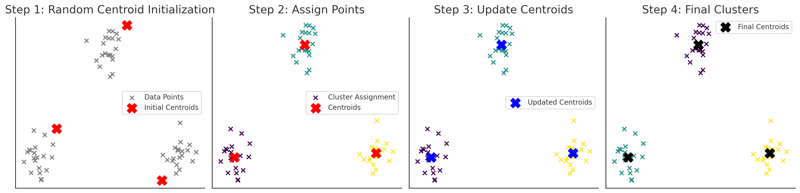
How K-Means Works?
Initialize: Randomly place K centroids in the data space.
Assign: Assign each data point to the nearest centroid.
Update: Compute the new centroid as the mean of assigned points.
Repeat: Continue until centroids no longer change

Slide 4
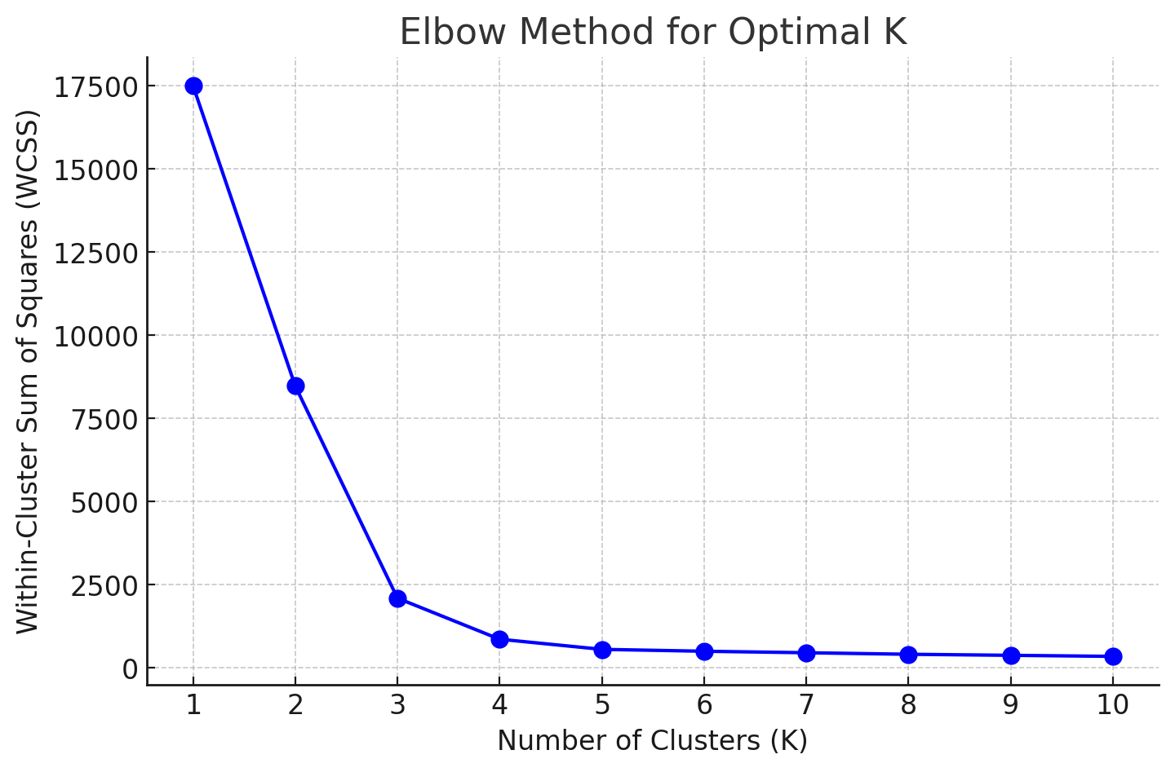
Choosing the Value of K & The Elbow Method
Why Choosing K is Important?
A small K may under-cluster, missing patterns and oversimplifying the data.
A large K may over-cluster, capturing noise and reducing interpretability.
The right K provides a balance between granularity and generalization.
The Elbow Method:
The Within-Cluster Sum of Squares (WCSS) measures cluster compactness.
A plot of WCSS vs. K typically shows a steep drop initially.
The 'elbow point' is where the reduction in WCSS slows down.
This optimal K ensures effective clustering without unnecessary complexity.

Slide 5
Metrics for K- Means Clustering
Metric | What It Measures | Ideal Value | Interpretation
WCSS (Within-Cluster Sum of Squares) | Measures total variance within clusters. | Lower is better | Lower WCSS = more compact clusters.
Silhouette Score | Measures how well-defined clusters are. | Closer to 1 | High values mean distinct clusters.
Davies-Bouldin Index (DBI) | Measures separation & compactness. | Lower is better (<1 preferred) | Low DBI = well-separated clusters.
Dunn Index | Measures inter vs. intra-cluster distances. | Higher is better (≥1 preferred) | High Dunn Index = well-separated clusters.

Slide 6
Market Basket Analysis

Slide 7
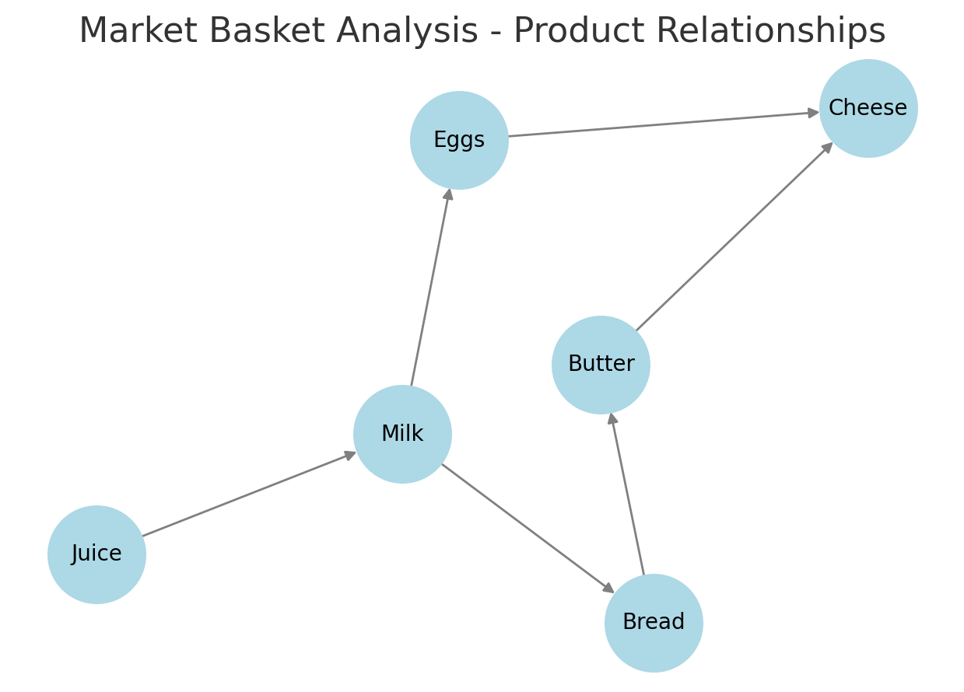
What is Market basket analysis?(MBA)
Market Basket Analysis (MBA) is a data mining technique that identifies relationships between items frequently purchased together.
It helps businesses understand customer buying behavior and optimize product placement, marketing strategies, and recommendations.

Slide 8
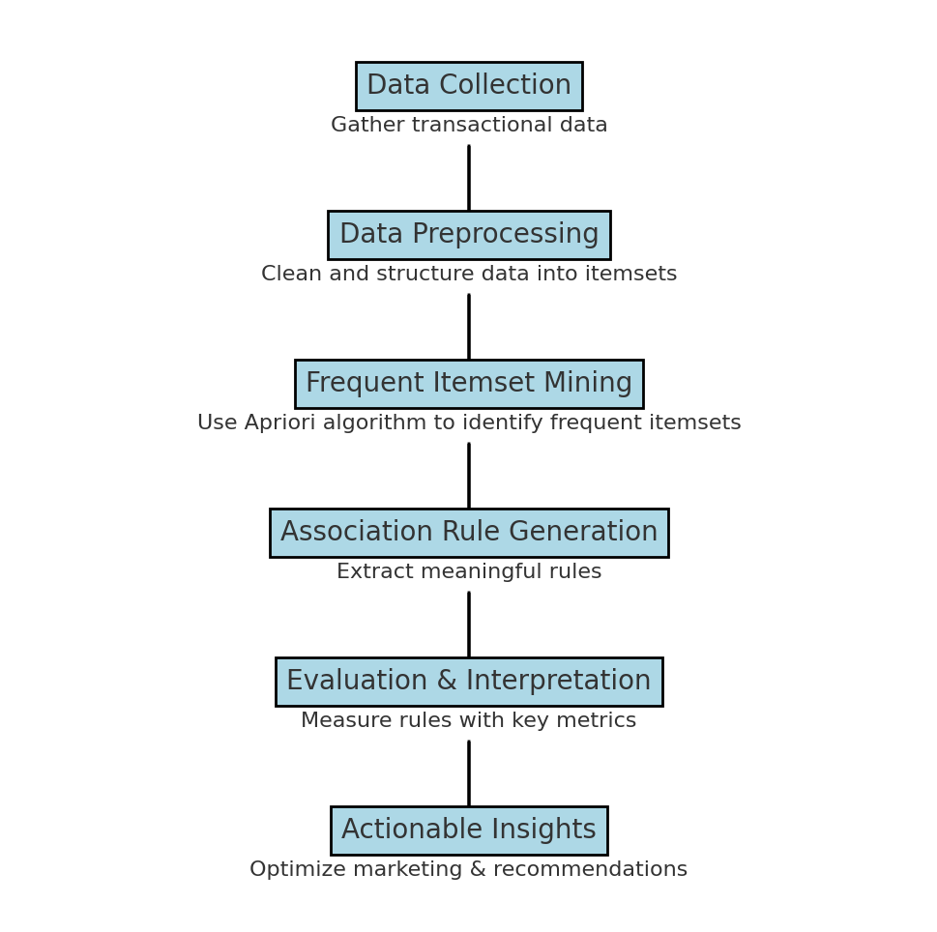
How MBA works?

Slide 9
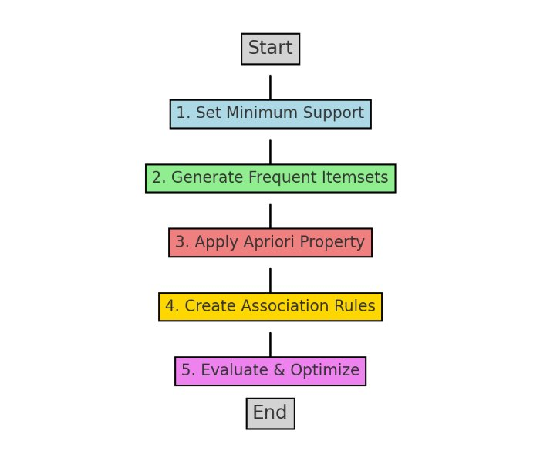
Apriori Algorithm - Working
Set Minimum Support
Define the minimum threshold for frequent items.
Generate Frequent Itemsets
Identify item combinations that meet the support threshold.
Apply Apriori Property
If an itemset is frequent, its subsets must also be frequent.
Create Association Rules
Extract rules based on confidence levels.
Evaluate & Optimize
Use metrics like lift and conviction to refine rules.

Slide 10
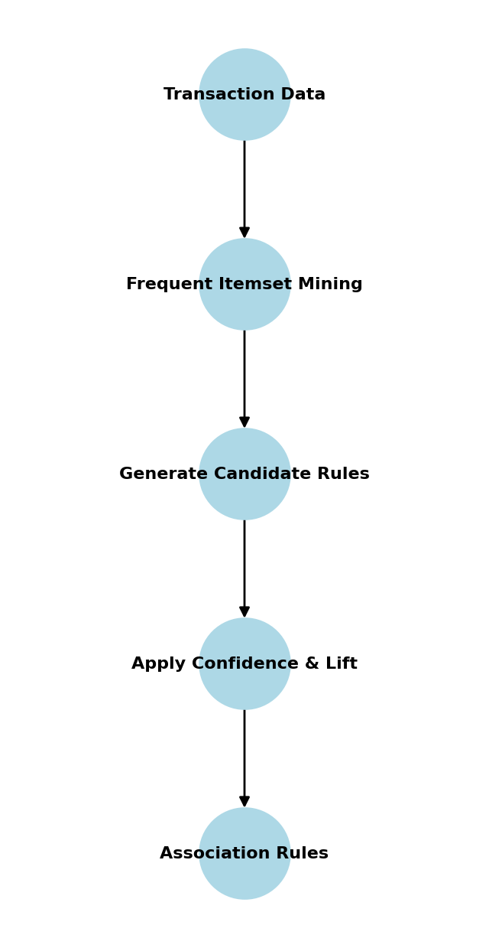
Association Rules in MBA
Association rules identify relationships between items.
If {A} → {B}, it means customers who buy A are likely to buy B.
Metric | Definition | Formula | Interpretation
Support | Measures how frequently items appear together. | Support(A→B) = (Transactions containing {A, B}) / (Total Transactions) | Higher support means the rule applies to more transactions.
Confidence | Measures how often B is bought when A is bought. | Confidence(A→B) = Support(A→B) / Support(A) | Higher confidence means a stronger relationship.
Lift | Measures how much more likely A and B are bought together than if independent. | Lift(A→B) = Confidence(A→B) / Support(B) | Lift > 1 indicates a strong association.
Conviction | Measures how much the presence of A increases the probability of B. | Conviction(A→B) = (1 - Support(B)) / (1 - Confidence(A→B)) | Higher conviction means stronger dependence.

Slide 11
What is the FP-Growth Algorithm?
FP-Growth (Frequent Pattern Growth) is an efficient algorithm for frequent itemset mining.
It is used in market basket analysis, recommendation systems, and web usage mining.
Why is it needed?
Traditional algorithms (like Apriori) generate many unnecessary candidate itemsets.
FP-Growth reduces computational complexity by using a tree-based approach.
Feature | FP-Growth | Apriori
Approach | Tree-based (FP-Tree) | Candidate-generation
Efficiency | Faster, fewer scans | Slower, multiple scans
Memory Usage | High (stores FP-Tree) | Lower but generates many candidates
Scalability | Works well for large datasets | Slows down with dataset size
Candidate Generation | No candidate itemsets | Generates many candidates
Best For | Large datasets, complex patterns | Small datasets, simple patterns

Slide 12
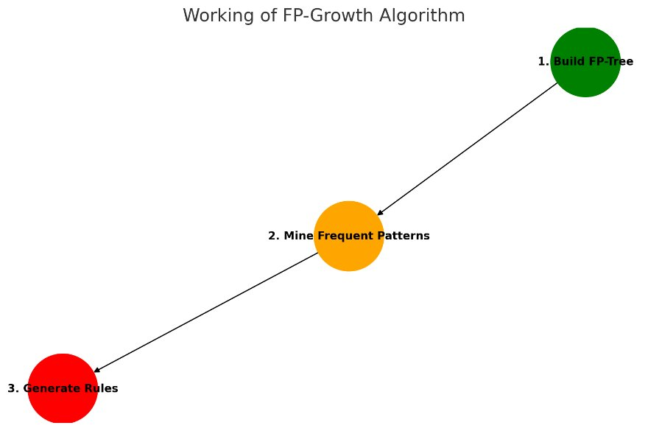
Working of FP-Algorithm
Build FP-Tree → Sort items, construct a compact tree.
Mine Frequent Patterns → Traverse tree & extract frequent itemsets.
Generate Association Rules → Compute support & confidence for decision-making.

